Slide 1
Love in Nicholas Sparks Movies
By Emily Rebenstock

Slide 2
Before I begin…
Fairytales
Stupid
Sappy
Unrealistic
Exhausting
Impractical
Picture Perfect

Slide 3
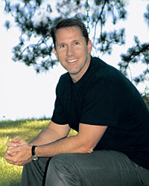
Who is Nicholas Sparks?
Born on December 31, 1965 in Omaha Nebraska.
He, his wife and his five children live in New Berg, North Carolina.
An American novelist, screenwriter and producer.
All 17 of his published books have been New York Times bestsellers.
9 of his Romantic-drama books have been adapted to film.
USA Today: “You read romance because you know what to expect. You read a love story because you don’t know what to expect.”.
He claims he is not a romance novelist but a fiction writer who writes love stories.

Slide 4
His Writing Style
Q: You once said the difference between a love story and a romance is that “love stories must use universal characters and settings.” What did you mean by that?
“Universal” means you feel as if they are real. You feel like you can know them. I don’t write stories about astronauts or CEOs of Fortune 500 companies or millionaires or movie stars. These are stories of everyday people put into extraordinary events that are also very real in ordinary people’s lives: accidents, a past you want to get away from, a husband that got violent.
These are stories where, when people sit down to watch them in the theater, they feel as if they know someone like Katie on screen, and they feel as if they know someone like Alex. That’s what draws them in. They relate to these characters, they begin to root for these characters and by the end they are moving in sync with the emotions of these characters. You need to do all of these things well to have a love story that works.

Slide 5
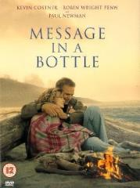


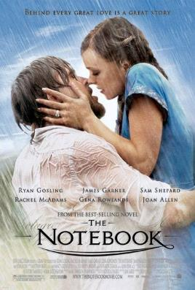



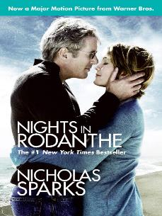

Nicholas Sparks Movies

Slide 6

Self-Presentation in The Notebook
Self-Presentation – the process of creating a desired impression, to elicit liking from another, instead of revealing one’s true self.
Noah sees Allie at a carnival and is immediately drawn to her.
After facing rejection, Noah sees Allie on the street a few days later and uses self presentation tactics to get Allie interested in him as well.
https://www.youtube.com/watch?v=xlK3FkdUv78

Slide 7
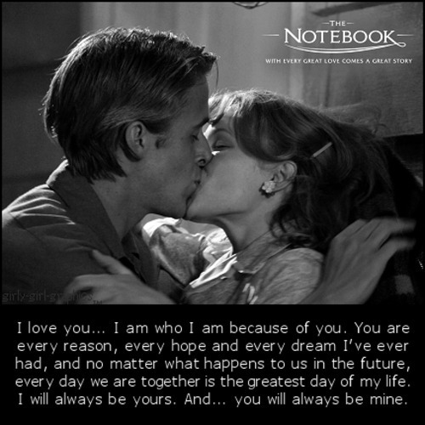
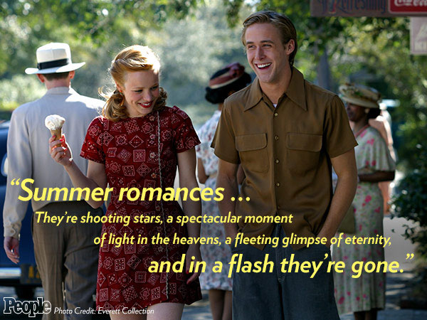
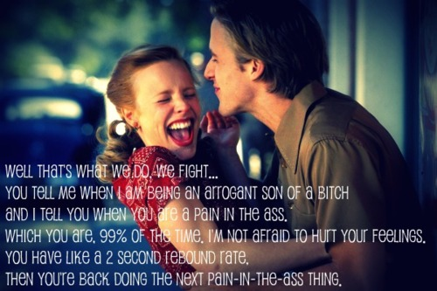

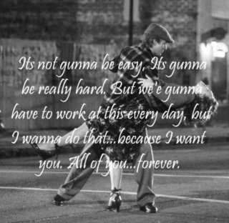
Additional Love Quotes from the Notebook

Slide 8
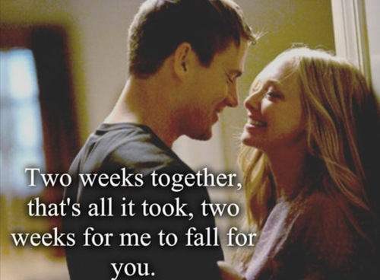
Attributional Statements in Dear John
John and Savannah meet on a beach when John saves her purse after it falls from a high ledge.
John is on leave from the military, while Savannah is volunteering during her summer vacation.
After their first date, they get caught in the rain.
https://www.youtube.com/watch?v=7xJTyRffRdo
Attributional Statements? Social penetration theory of self-disclosure?
After this kiss in the rain, the two are inseparable for the remaining two weeks they have together.

Slide 9
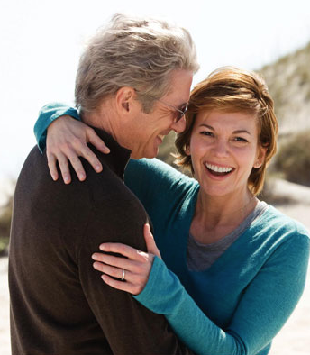
Contrast Principle in Nights in Rodanthe
Contrast principle- when a person’s perception about a person is different because they compare them to a previous stimuli.
Adrienne, a middle aged woman, is staying in her friends inn for the weekend to get away for the weekend.
The only other guest at the Inn is a man named Paul, who has come away for the weekend to try to fix the mistakes that haunt his past.
Both broken hearted, come together and find comfort in one another as a storm keeps them shut inside the Inn for the weekend. The two realize that their lives are not over, and that they should not settle, because new and real love does exist, even in their later years.
https://www.youtube.com/watch?v=18D7XgB7ZJ0

Slide 10

Violence in Safe Haven
Katie runs away from her past, to a small town in North Carolina.
While settling in, she meets a widow named Alex, who takes interest in her.
After some time, Katie and Alex fall in love, and Katie reveals the real thing she was running from: Her abusive ex-husband.
https://www.youtube.com/watch?v=s-Vi_kgBL3E
“The message there is people get second chances in life. If you want any message to take away, your past need not find you and second chances are possible. I think both of those are wonderful messages, because I think everybody, quite frankly, will appreciate hearing them.”

Slide 11
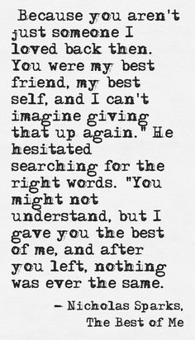

Misattribution of Arousal in The Best of Me
Dawson and Amanda are very classically from opposite sides of town.
Dawson has a troubled home life, but his love for Amanda makes him want to be a better person for her.
He climbs into her window at night, they sneak behind their parents’ backs, they kiss in the rain and spend every moment together. https://www.youtube.com/watch?v=JyQ-M0lHi7A
But there’s an altercation, and Dawson is sent away to prison for something that wasn’t his fault.
21 years later, they are brought back together.
https://www.youtube.com/watch?v=hx85o3Z43Yk
Does the story simply have high stakes? Or do these teens truly experience real love?

Slide 12

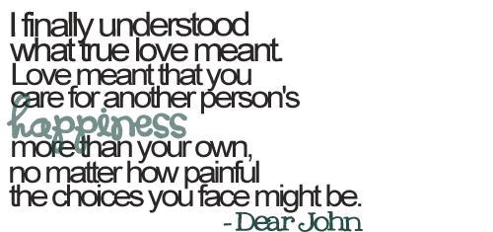
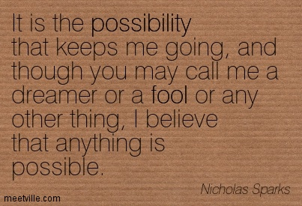


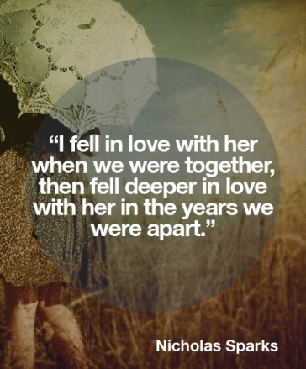
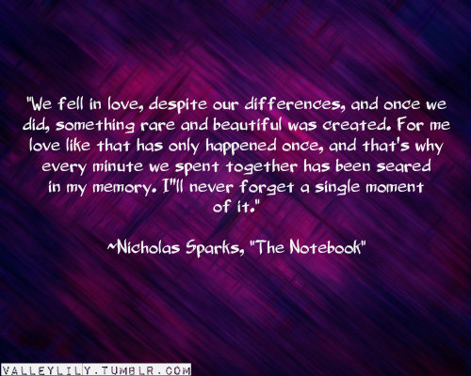

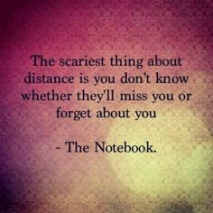
Nicholas Sparks Quotes on Love

